Slide 1
FashionNXT-EventNXT
Team Members: Rishabh Pagaria, Neil Gautam,Parth Tausham, Venkata Cherukuri, Kiara Sims, Ming-Sheng Xu

Slide 2
EventNXT Application Overview
EventNXT is an application designed to enhance guest list management for live events. From managing seating level to sending emails.
Goals:
Equip event organizers with real-time ticket information.
Efficiently manage seating capacities.
Optimize box office ticket sales to enhance the user experience for event organizers.
Key features:
Sign-in, sign-out, and authentication via Event360 CRM.
Event creation and management tools.
Seating and guest summaries with management options.
Box office sales integration using Excel and third-party APIs (i.e. Eventbrite)
Email communication functionality for RSVP
Referral rewards program.

Slide 3
Features

Slide 4
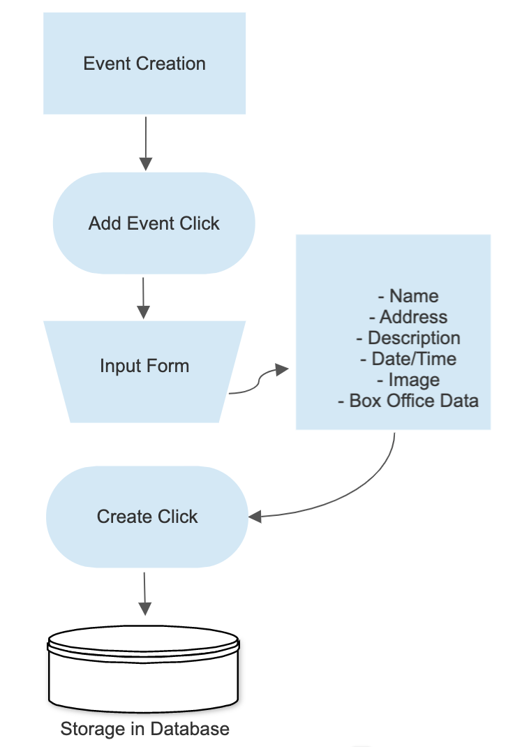
Event Creation

Slide 5
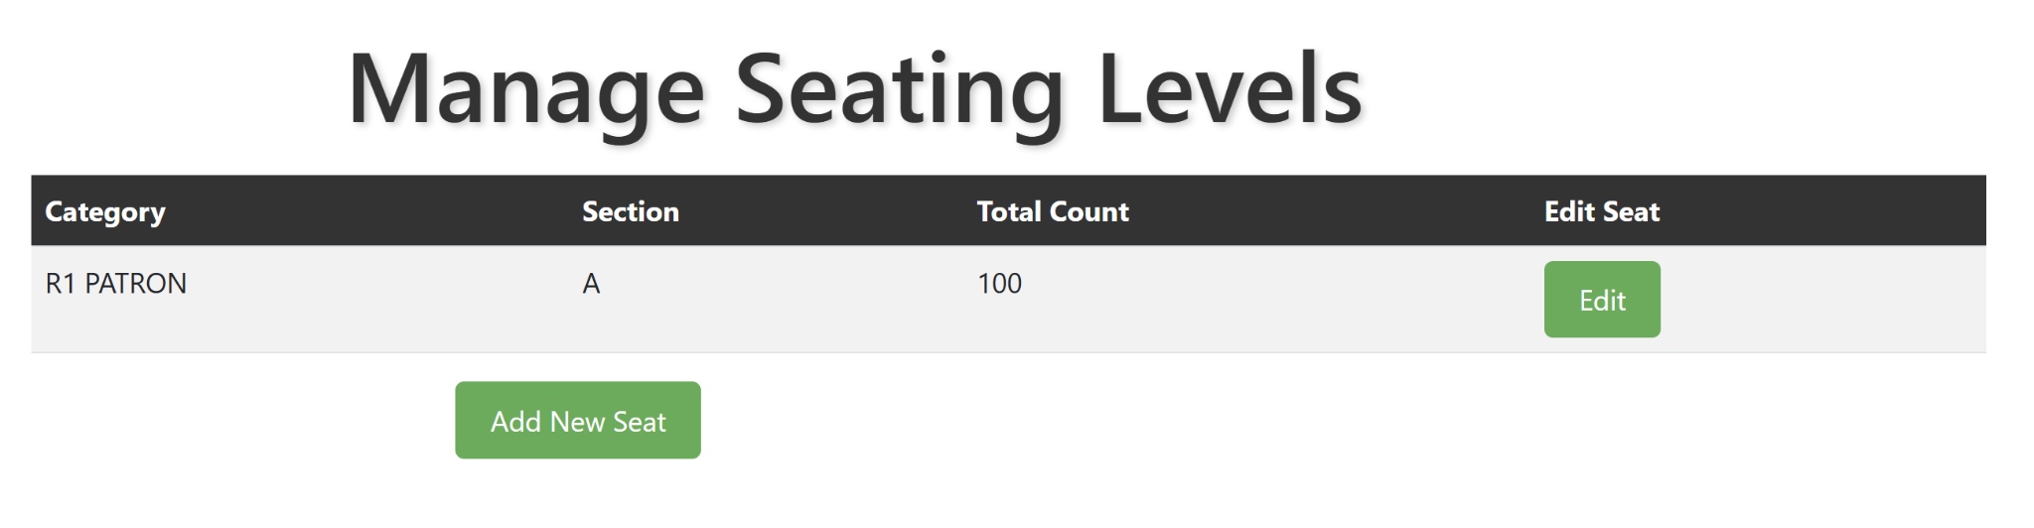
Managing Seating Levels for an Event
Upload box office data using a spreadsheet
The application automatically displays seating categories.
Edit seating count, initially set to 0
Add or delete seating categories as required

Slide 6
Managing Guests
Event managers can import a guest list through CSV file uploads.
Event managers can export or download guest details, including seat allotment and commitments across different categories.
Seating Summary Information
Displays all seating categories, the count of seats allotted to guests, and the tentative number of free seats remaining after allotment.

Slide 7
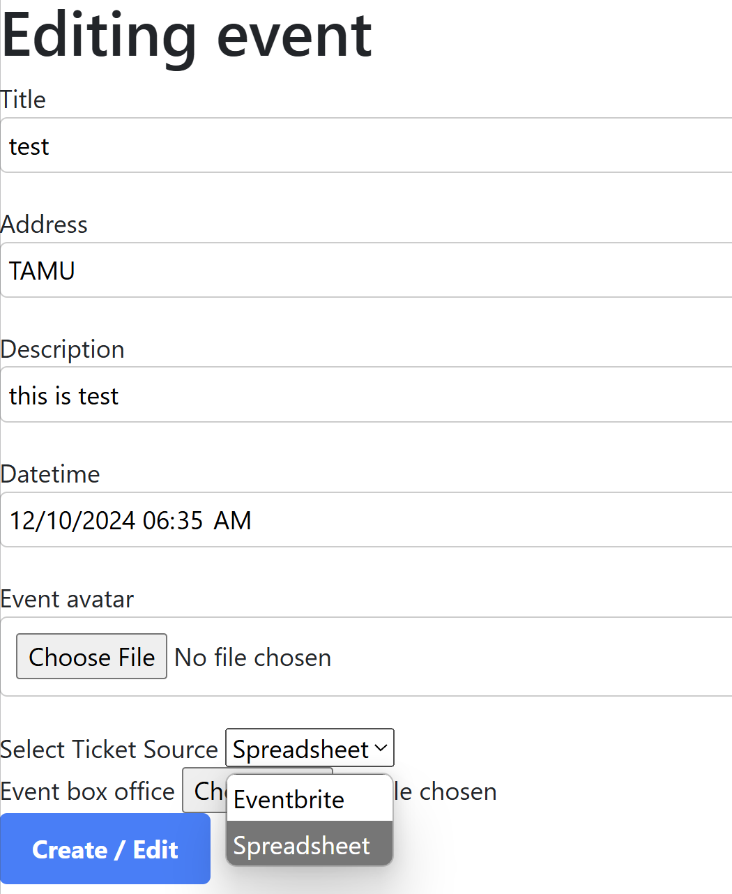
Box office ticket sales
There are 2 ways for which the data can be fetched
Spreadsheet (i.e. using excel file)
Firstly, change the ticket source from the event’s edit section
Event managers can import the box office ticket sales using the spreadsheet.
Go to event’s page, click choose file and then upload the spreadsheet.
The box office ticket sales data can be viewed at the box office section.

Slide 8
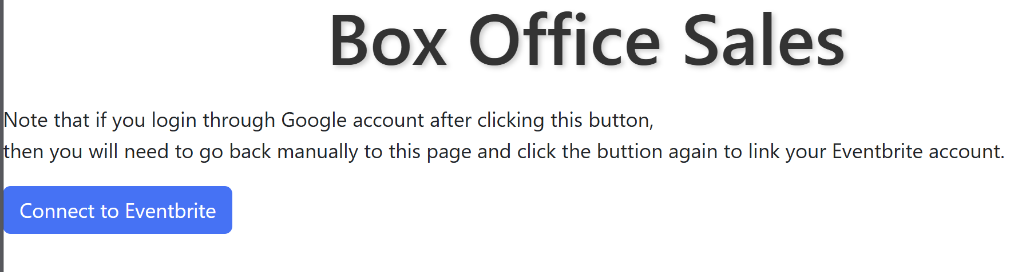
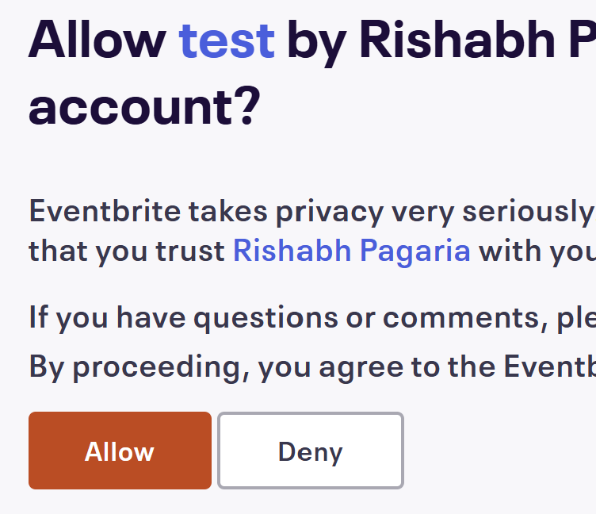
Box office ticket sales
There are 2 ways for which the data can be fetched
Eventbrite (i.e. using external API)
Firstly, change the ticket source from the event’s edit section
Event managers can import the box office ticket sales using Eventbrite API
Click on Connect to Eventbrite button, and then the app would be prompted if you want the eventNXT app to be connected to eventbrite. Click on Allow.
The API is connected, select the desired event, the box office ticket data is visible.

Slide 9
Referral Invitations & Rewards
- Send referral invitation emails to guests.
- Guests can share referral emails through a unique link.
- Referral data is automatically updated in the "Manage Referrals" table.
- Referred guests receive an email containing a purchase link.
- Rewards can be offered either per ticket or as a percentage of the amount spent.

Slide 10
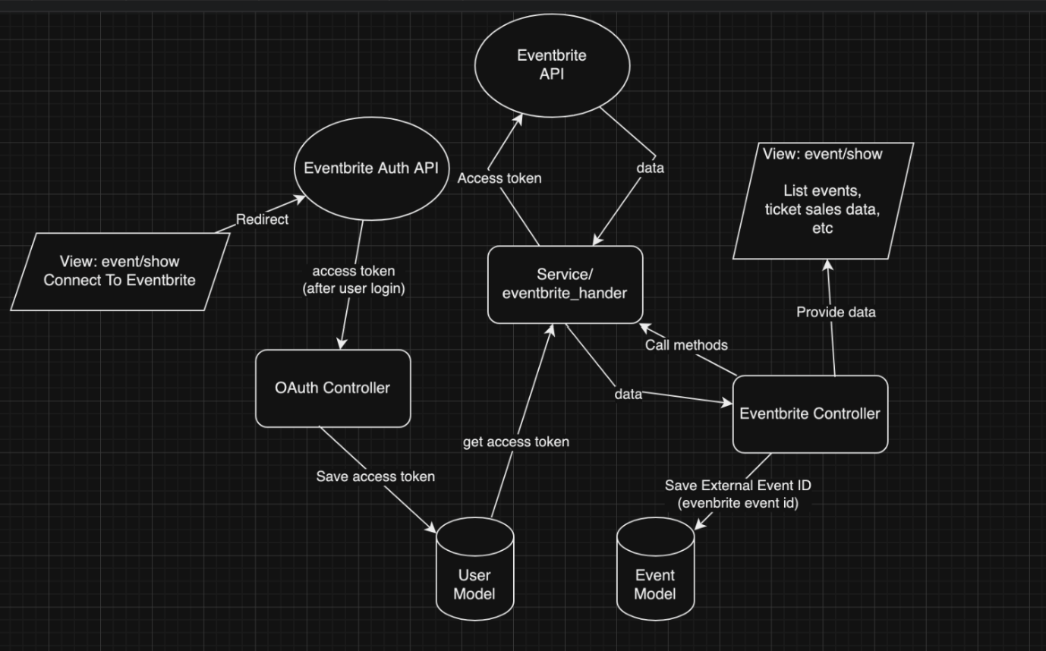
Design diagram for Eventbrite

Slide 11
Front-End Revamp
The client requested flags or warnings to be shown for some of the edge cases for guest management, event management, seating summary details.
Removing the some bloatware html code from the email services.
Making the email services more appealing by adding buttons for the individual email actions.
Added “Modify button” inside email service to hide or make the email template summary visible as it gets clicked.
Removed the event managers login page and connected to the events360 (i.e. the main CRM tool)

Slide 12
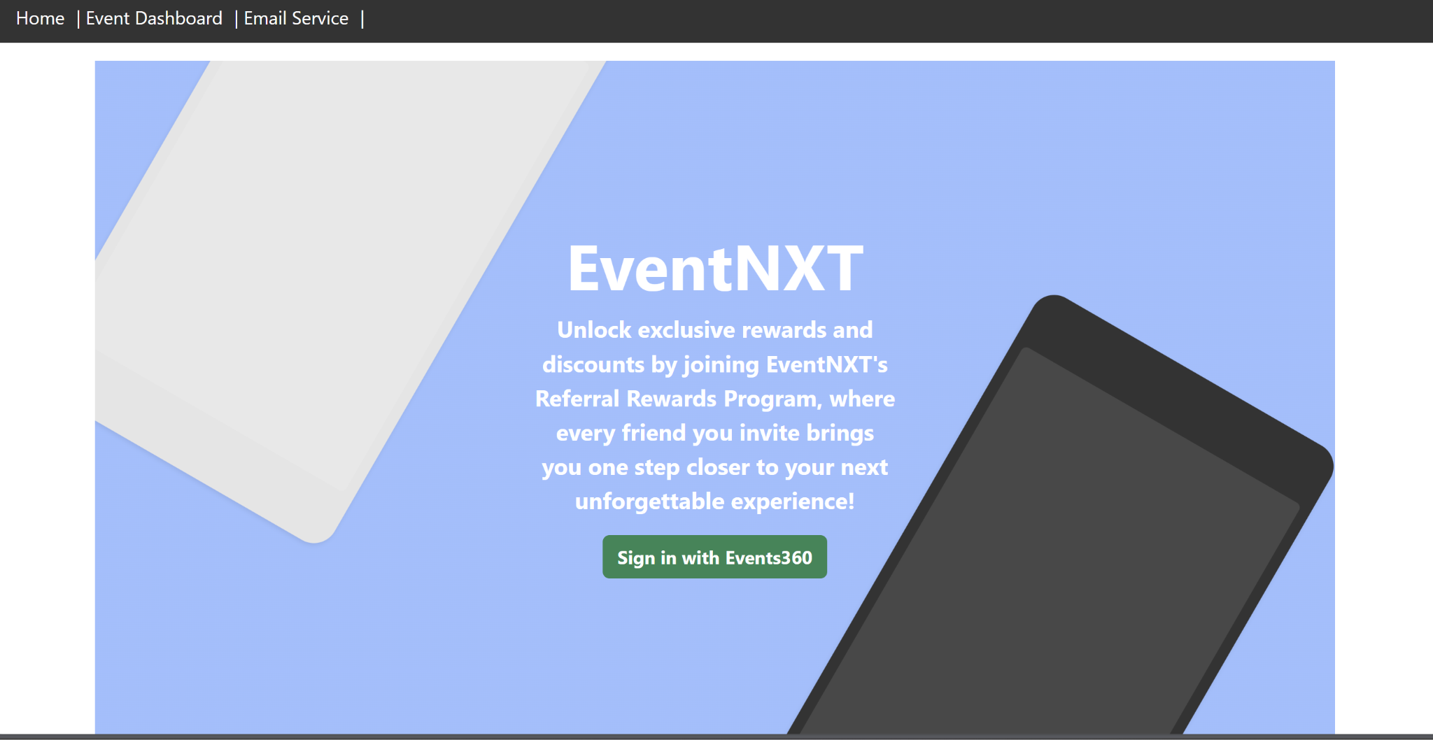
Sign in page

Slide 13
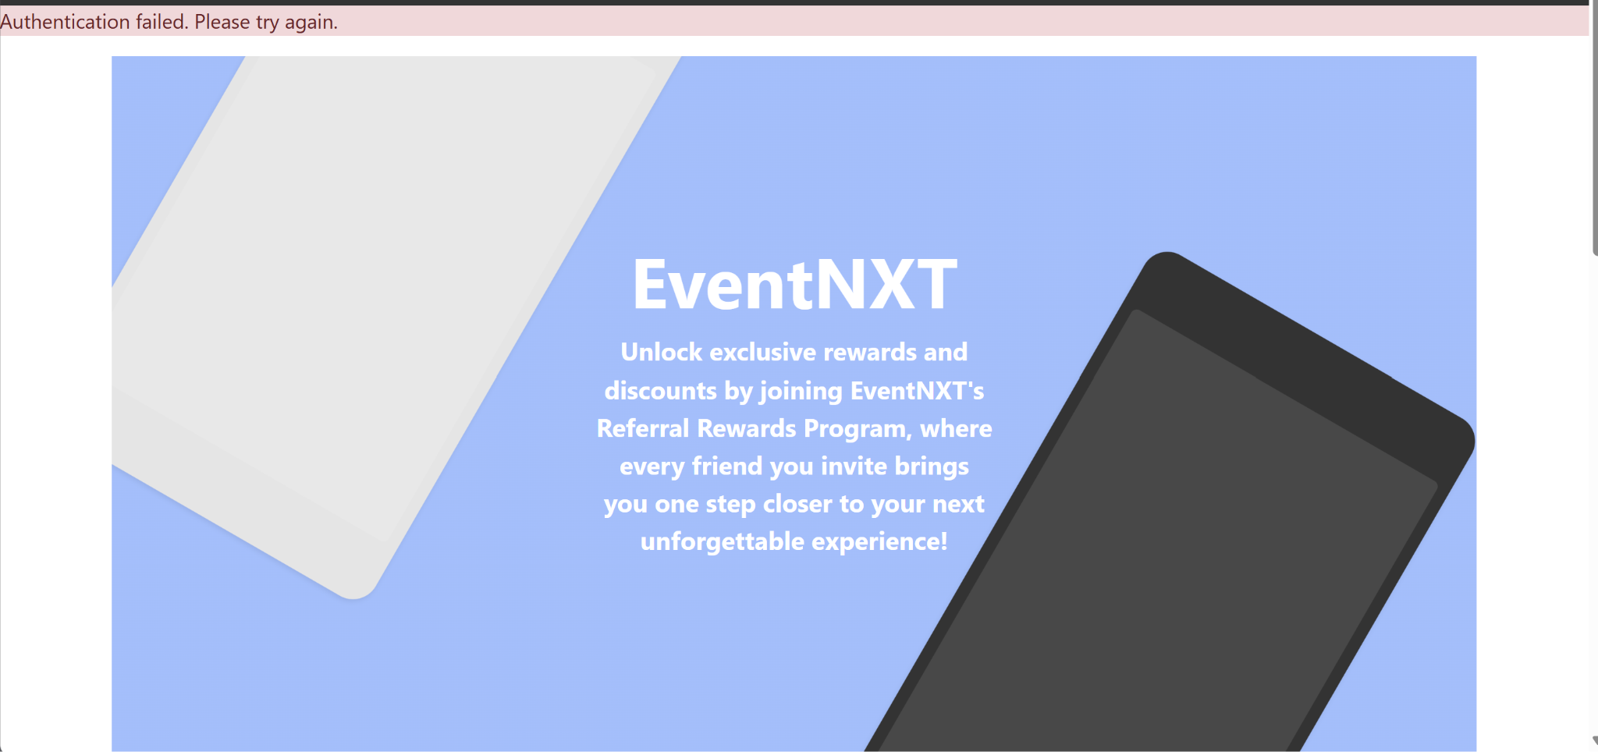
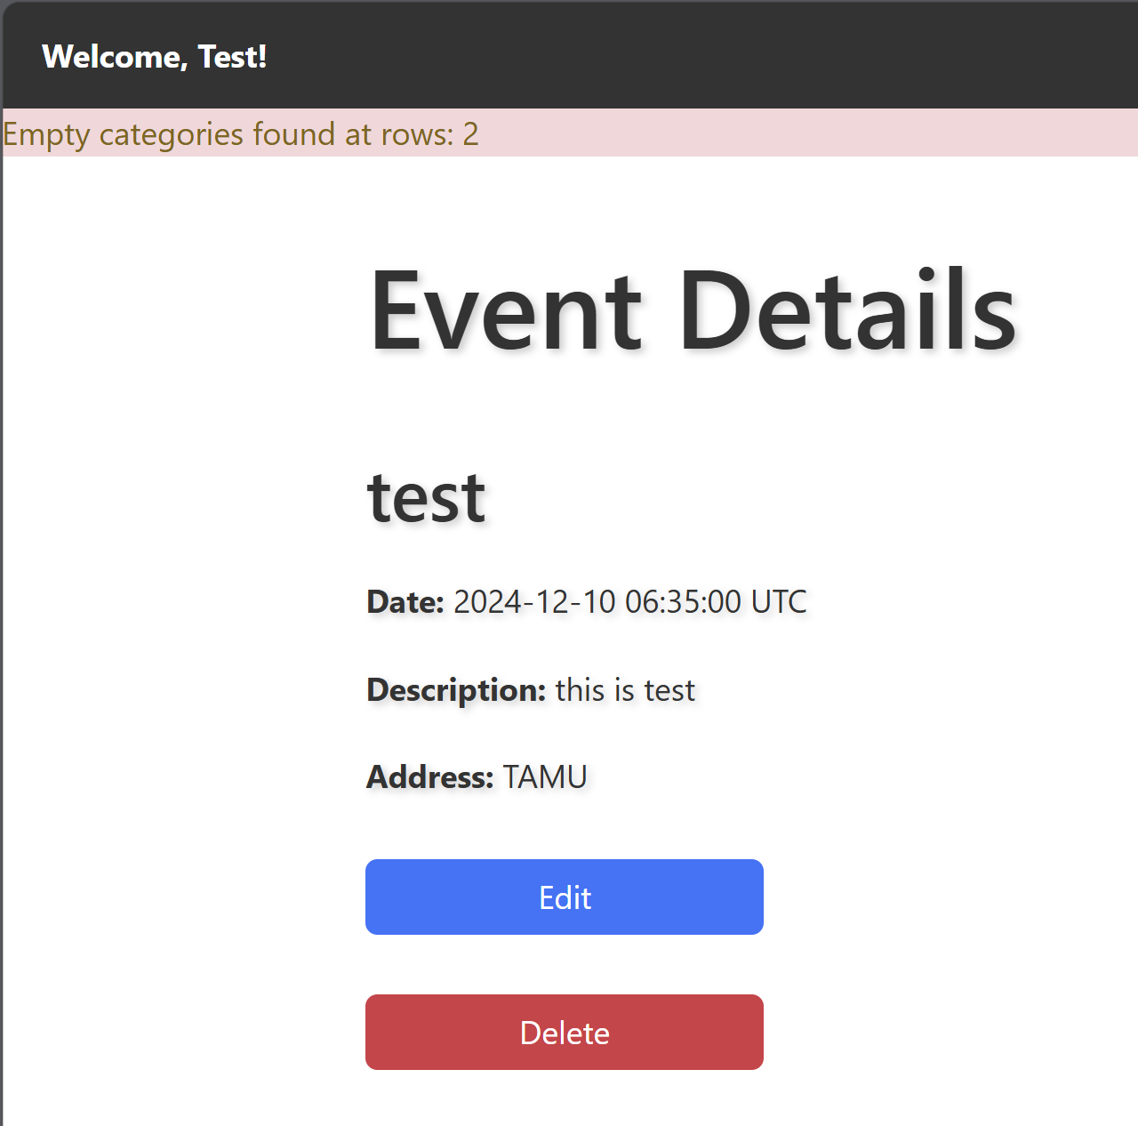
User Warnings/Flags

Slide 14
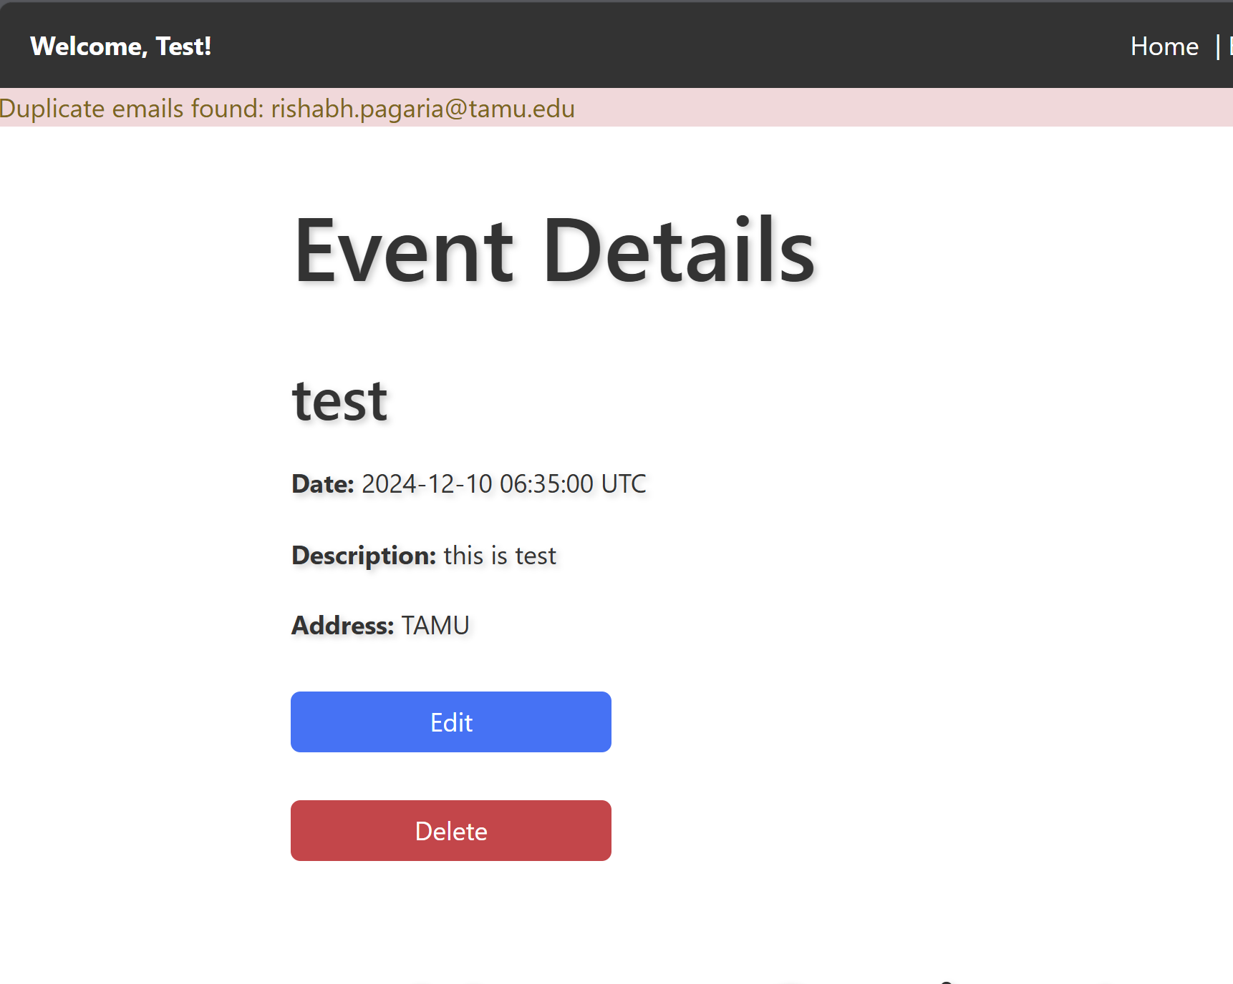
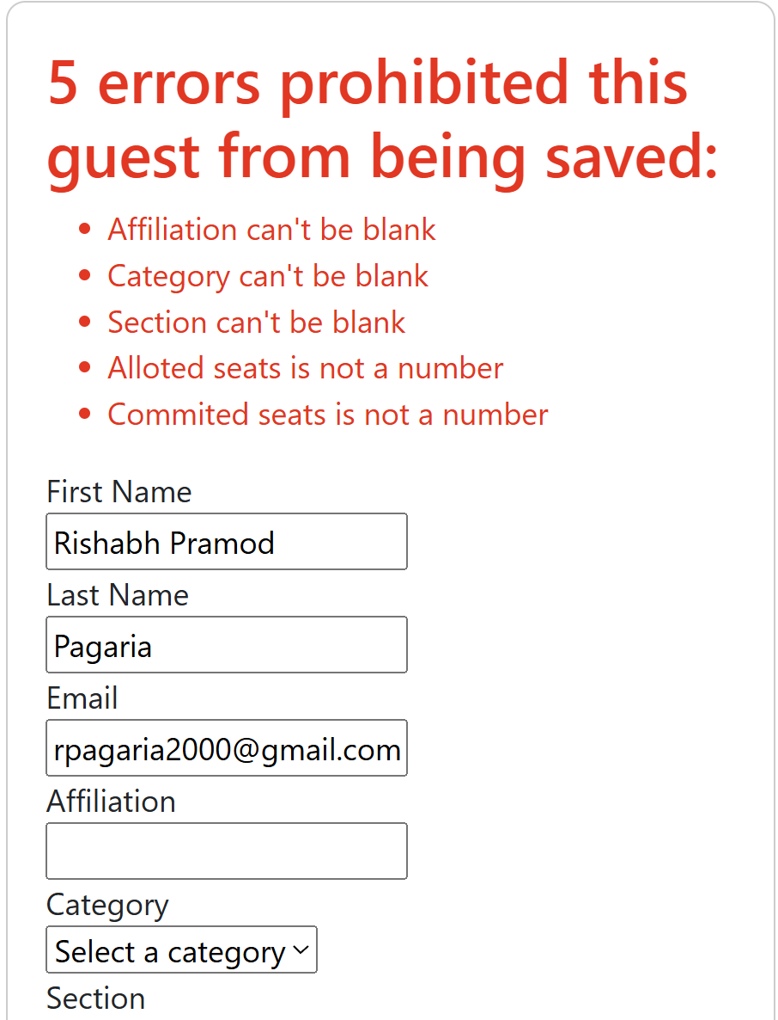
User Warnings/Flags

Slide 15
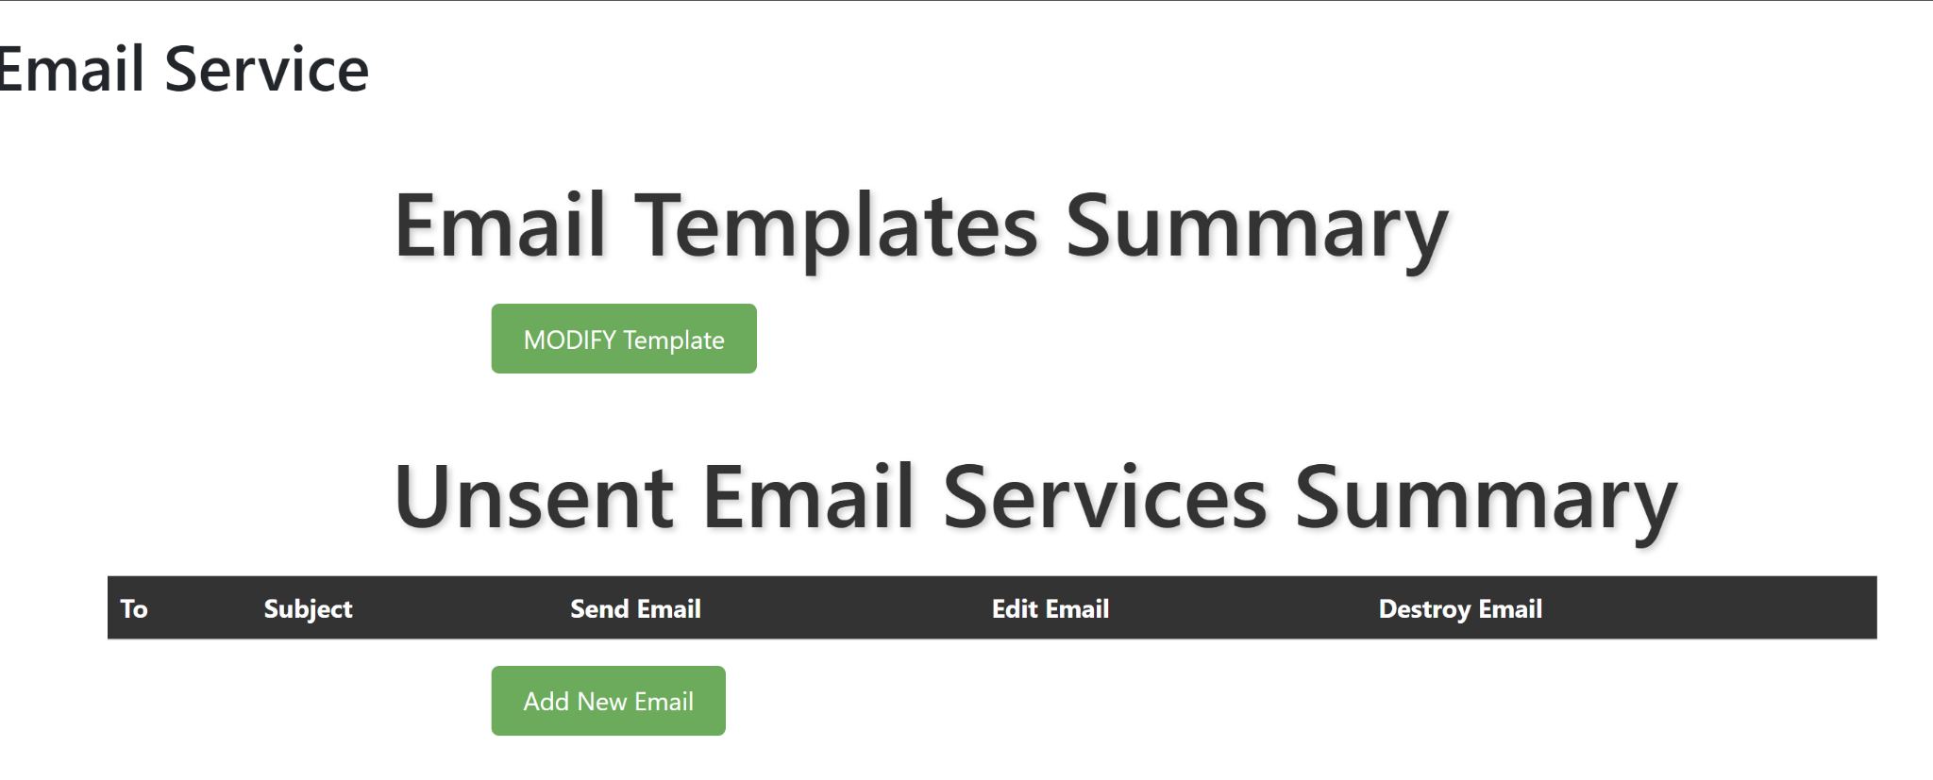
Email Service
Before click

Slide 16
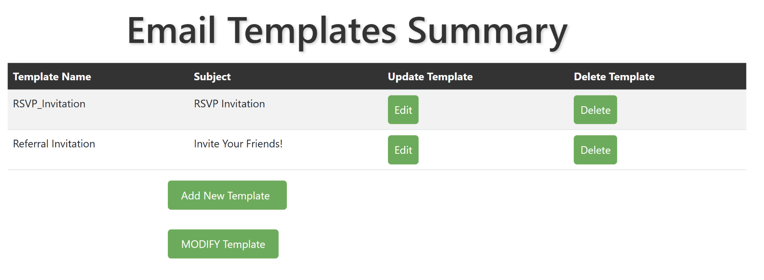
Email Service
After click

Slide 17
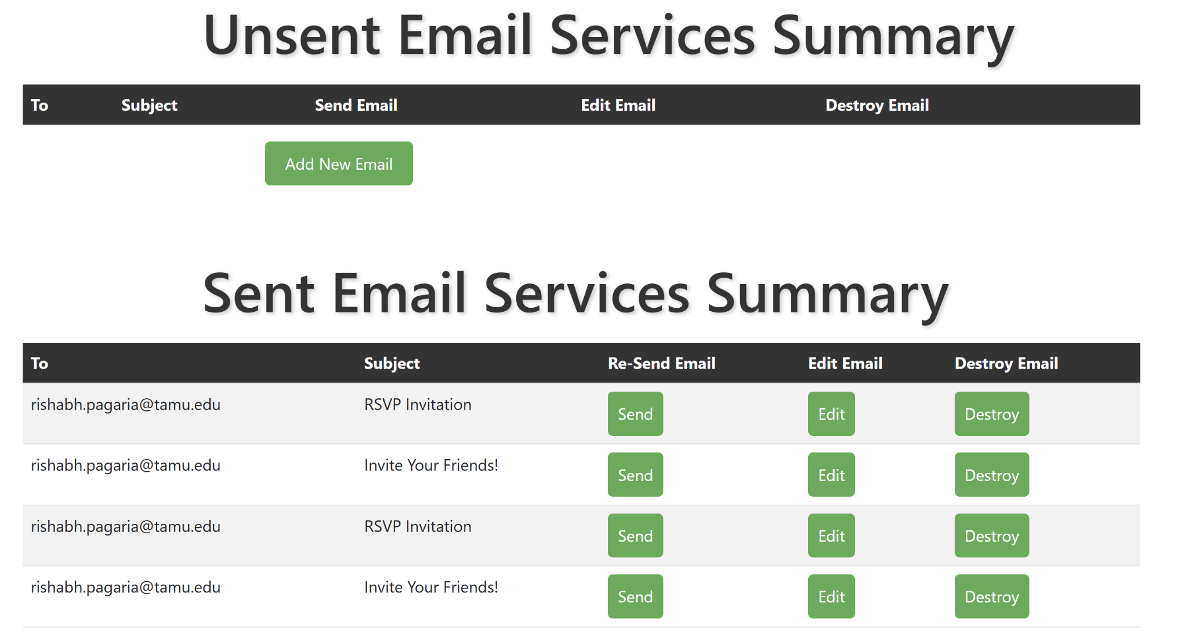
Email Service

Slide 18

Challenges
Gaining proficiency in Ruby and Rails.
Overcoming challenges and understanding the legacy code.
Fixing the bugs, i.e. some of the main functionalities was not working.
Managing version control effectively.

Slide 19
Re-engineering EventNXT
Rebuilt the app to address authentication issues, bugs, and complexity.
Achieved seamless CRM integration.
Enhanced app performance for better user experience.
Developed a clean and consistent Ruby codebase.
Created comprehensive documentation for easier maintenance.
Prioritized efficient feature implementation.

Slide 20
Lessons Learned
Team collaboration
Effective communication
Handling conflicts
Leadership
Agile methodology

Slide 21
Thank You

